Slide 1

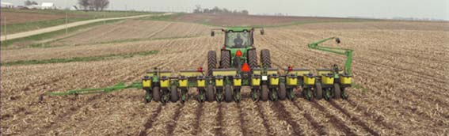
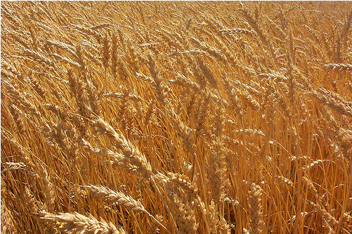
Modeling Climate Change Impacts on Agricultural Production and
Implications for Risk Management
Robert H. Beach

Slide 2
Collaborators
Bruce McCarl and Dmitry Vedenov, Texas A&M
Rod Rejesus, North Carolina State University
Allison Thomson and Cesar Izzauralde, PNNL
Chen Zhen, RTI (now at University of Georgia)

Slide 3
Introduction
Agricultural production is inherently risky, dependent upon weather and other factors
Crop insurance is one important mechanism for managing yield, price, and quality risks
  Federally subsidized crop insurance available in the US since 1938
  Major changes over time with addition of crops and insurance products
Climate change may lead to more rapid changes in mean yields as well as yield and price variability than in the past, making adjustment more difficult
  Extreme events
  Historical experience less informative
  Faster depreciation of research/knowledge stock
Complex set of interactions between impacts with heterogeneity across time and space

Slide 4
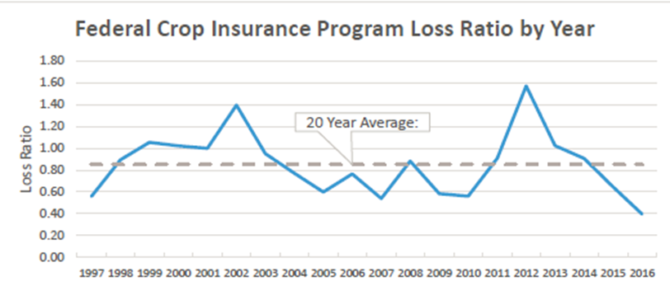
US Crop Insurance Program
Annual enrollment prior to planting
Coverage based on
  Recent yield history
  Price forecasts
  Futures contracts
Multiple-peril insurance, revenue and index based plans
Premium rates based on coverage and risk
Indemnity paid if index is triggered or the yield and/or revenue at end of season is below guarantee
Source: USDA RMA, 2017

Slide 5
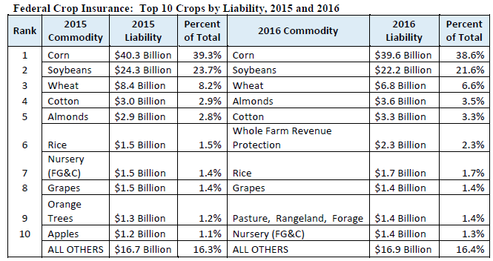

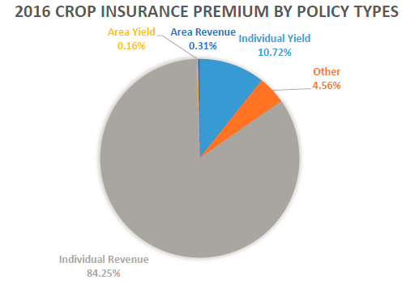
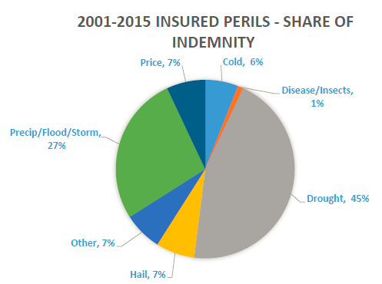
Crop Insurance Liabilities, Premiums, and Indemnities

Slide 6
Crop Insurance Terms
YP = Yield Protection (previously referred to as APH = Actual Production History)
RP = Revenue Protection (previously separate products referred to as Revenue Assurance (RA), Crop Revenue Coverage (CRC), and Income Protection (IP))
CAT = Catastrophic coverage (low cost, high deductible policy)
Coverage level = portion of yield or revenue insured (50-85% in 5% intervals)
Insurance product type
  A class of insurance contracts, e.g. YP vs. RP vs. CAT
Insurance product
  A contract with a specific coverage level, e.g. 65% YP vs. 70% YP etc.
Loss ratio = Indemnities/Premiums
Loss cost ratio = Indemnities/Liabilities

Slide 7
Public-Private Provision of Crop Insurance
Private companies deliver insurance locally through a network of agents
Federal Crop Insurance Corporation (FCIC) subsidizes policies and provides reinsurance for private companies
Terms of reinsurance are established through the Standard Reinsurance Agreement (SRA) — a cooperative risk-sharing agreement between FCIC and private insurance companies
Each policy can be assigned to one of three reinsurance funds
  Commercial Fund
  Developmental Fund
  Assigned Risk Fund
Commercial and Developmental funds are further subdivided into CAT, Revenue, and “Other Products” funds
Premium cession limits (how much of total premiums can be assigned to a fund)
  Limits for Assigned Risk Fund vary by state (25% to 75%)
  No restrictions on Commercial or Developmental funds
Once all policies are assigned, insurers
  cede a portion of all premiums and liabilities to FCIC (proportional reinsurance)
  share losses and gains on the retained portion of book of business with FCIC (non-proportional reinsurance)

Slide 8
Proportional Reinsurance
An insurer completely transfers a portion of net premiums and associated liabilities to FCIC
Retention requirements (how much the insurer has to keep on its balance)
  Assigned Risk Fund — between 15% and 25% (depends on the state)
  Developmental Fund — at least 35%
  Commercial Fund — at least 50%
Funds essentially operate on the state level

Slide 9
Non-proportional Reinsurance
Applies to the portions of portfolios retained (not ceded under proportional reinsurance)
Shares of losses and gains are determined based on the realized state-level loss ratios (indemnities paid divided by premiums collected)
  the higher the loss ratio above 100%, the larger the portion of losses covered by FCIC
  the lower the loss ratio below 100%, the larger the portion of gains claimed by FCIC

Slide 10
Schedules of Gains and Losses
 | Gains |  |  | Losses
Fund | CAT | Rev | Other | CAT | Rev | Other
 | Loss Ratio 65% to 100% |  |  | Loss Ratio 100% to 160%
COM | 75.00% | 94.00% | 94.00% | 50.00% | 57.00% | 50.00%
DEV | 45.00% | 60.00% | 60.00% | 25.00% | 30.00% | 25.00%
ARF | 15.00% |  |  | 5.00%
 | Loss Ratio 50% to 65% |  |  | Loss Ratio 160% to 220%
COM | 50.00% | 70.00% | 70.00% | 40.00% | 43.00% | 40.00%
DEV | 30.00% | 50.00% | 50.00% | 20.00% | 22.50% | 20.00%
ARF | 9.00% |  |  | 4.00%
 | Loss Ratio less than 50% |  |  | Loss Ratio 220% to 500%
COM | 8.00% | 11.00% | 11.00% | 17.00% | 17.00% | 17.00%
DEV | 4.00% | 6.00% | 6.00% | 11.00% | 11.00% | 11.00%
ARF | 2.00% |  |  | 2.00%

Slide 11
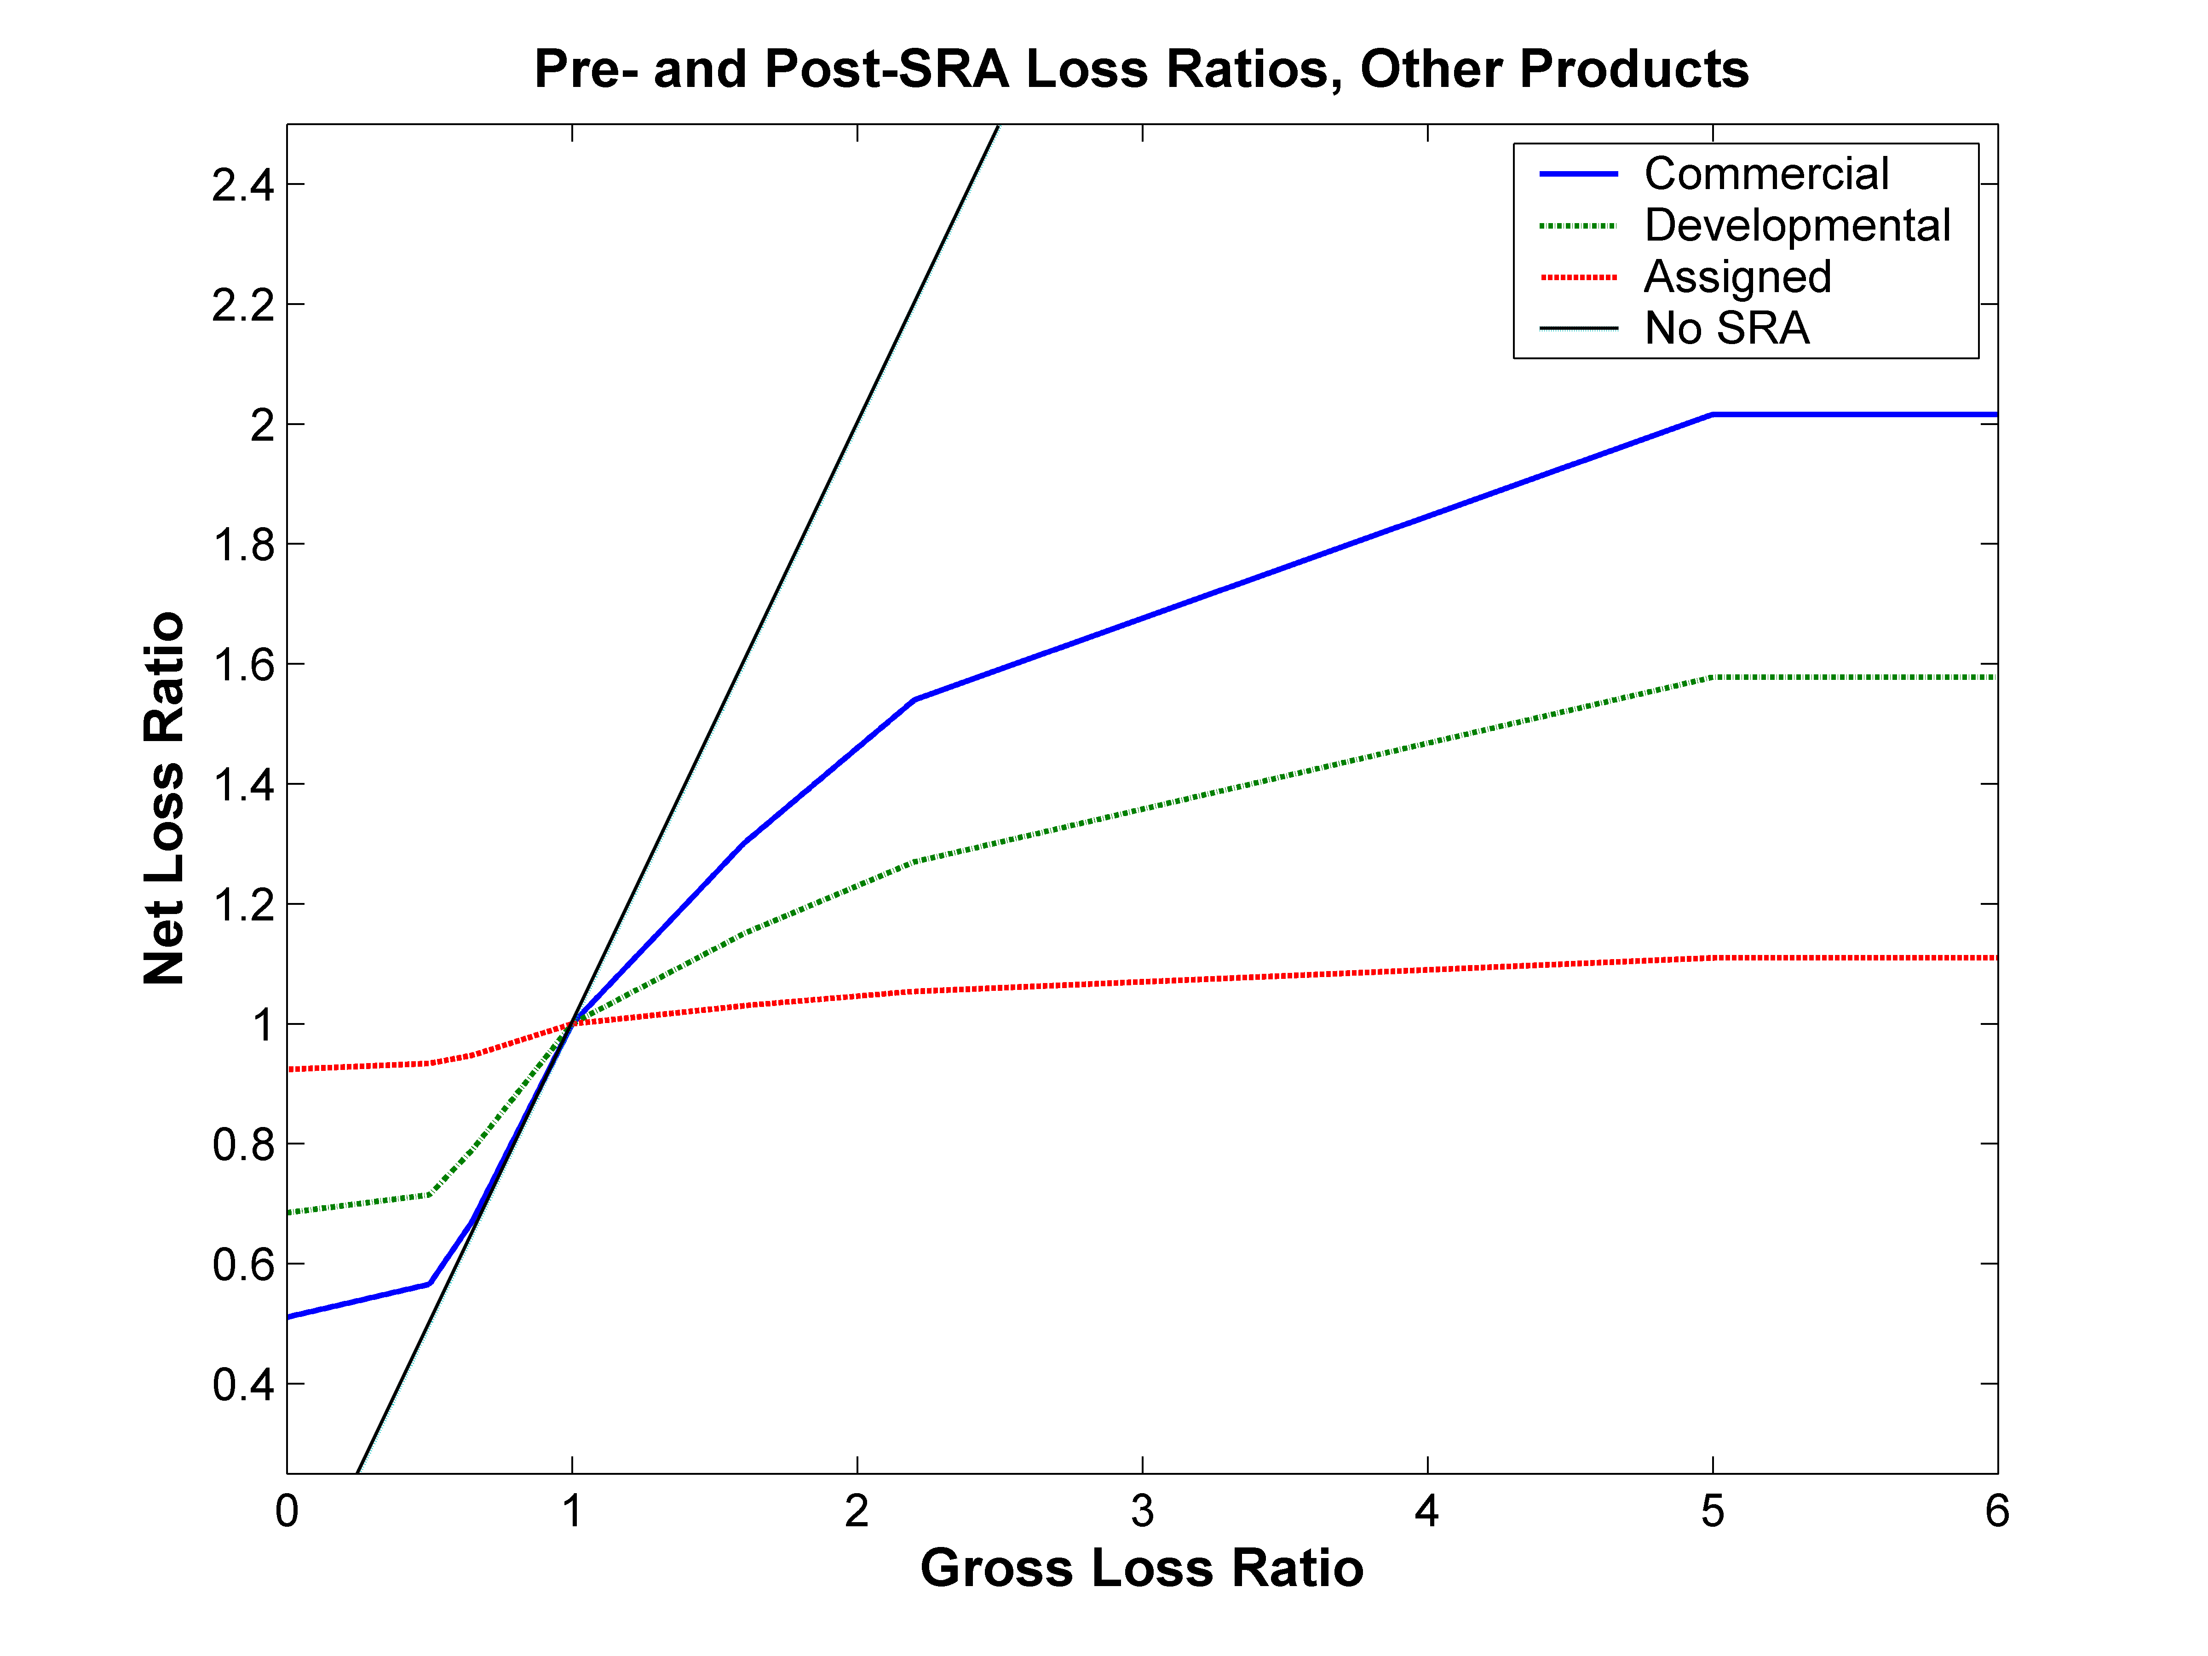
How SRA Transforms Loss Ratios
Aspect ratio 2:1

Slide 12
Potential Impacts of Climate Change on Agriculture
Typically not major impacts anticipated for U.S. agriculture in aggregate over at least the next few decades in the literature, but…
  Varies across scenarios and GCMs
  Many studies focus on mean yields, not necessarily on the tails of the distribution
  Dryland vs. irrigated
  National level results obscure substantial distributional impacts across regions
  Possible effects of pest and disease pressure and extreme weather events often ignored
  Ozone impacts not typically included
  Could be threshold effects
  Complex interactions
Crop insurance is an important risk management tool for agriculture
Effects on insurance program design under changing climate
  Changing risk relative to historical experience
  Financial exposure of private insurers and US government to catastrophic events

Slide 14
IPCC Scenario and GCMs Used
IPCC Scenario A1B was the scenario selected for all global circulation models
  Actual emissions have been above the A1B scenario so we felt it was reasonable to focus on that scenario vs. B1 and B2 scenarios with lower emissions given that there has also been interest in non-fossil fuel energy (vs. A1FI or A2)
GCMs (daily simulation data available for 2045-2054 and 1991-2000)
  GFDL-CM2.0 and GFDL-CM2.1 models developed by the Geophysical Fluid Dynamics Laboratory (GFDL), USA
    Both GFDL-CM2.0 and GFDL-CM2.1 are being included because they have substantially different seasonal precipitation patterns
  Coupled Global Climate Model (CGCM) 3.1 developed by the Canadian Centre for Climate Modelling and Analysis, Canada
  Meteorological Research Institute (MRI) Coupled atmosphere-ocean General Circulation Model (CGCM) 2.2 developed by the Meteorological Research Institute, Japan Meteorological Agency, Japan

Slide 15
Change in Average Spring and Summer Temperature and Precipitation: GFDL-CM2.0, 2045-2054
Spring
Summer

Slide 16
Change in Average Spring and Summer Temperature and Precipitation: GFDL-CM2.1, 2045-2054
Spring
Summer

Slide 17
Change in Average Spring and Summer Temperature and Precipitation: CGCM3.1, 2045-2054
Spring
Summer

Slide 18
Change in Average Spring and Summer Temperature and Precipitation: MRI-CGCM2.2, 2045-2054
Spring
Summer

Slide 19
EPIC Model
Process-level agro-ecosystem model
Has been used previously to simulate regional productivity of corn, soybeans, winter wheat, cotton, hay, and switchgrass for the U.S. at the 8-digit hydrologic unit scale
Additional cropping systems were added to include sorghum, rice, barley, and potatoes for the appropriate regions
  9 crops modeled using EPIC comprise about 83% of US crop insurance liability
Multiple soil types are represented within the 1,450 hydrologic units with agricultural production
Modeling system is currently using baseline climatology for 1990-2000 with IPCC SRES scenario A1B
Future projections incorporate GCM results from the Geophysics Fluid Dynamics Laboratory CM2.0 and CM2.1 models and the Canadian Center for Climate Modeling and Analysis CGCM model

Slide 20
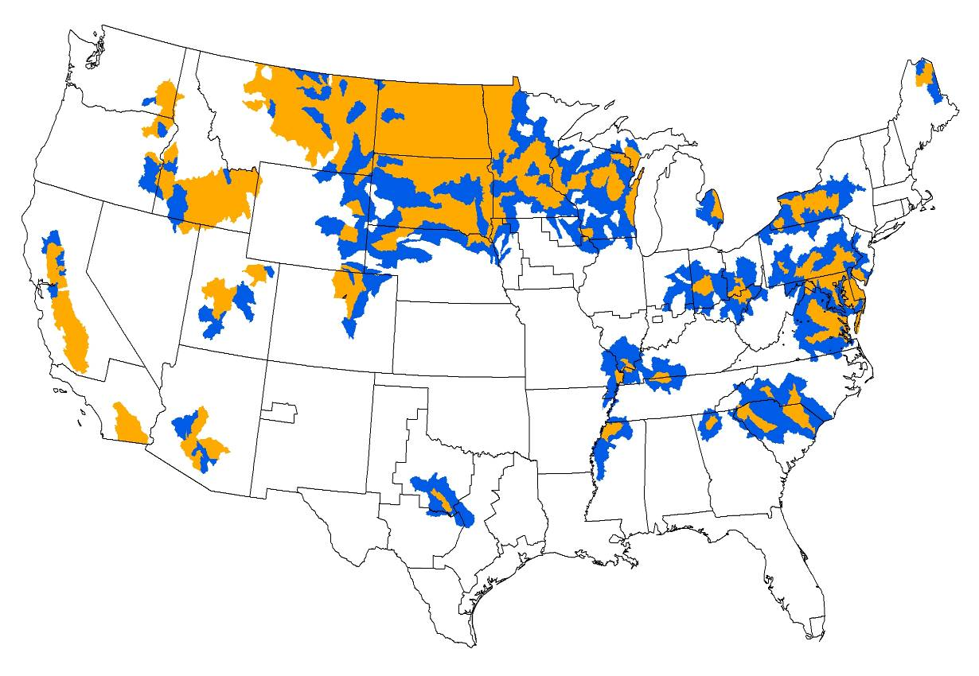
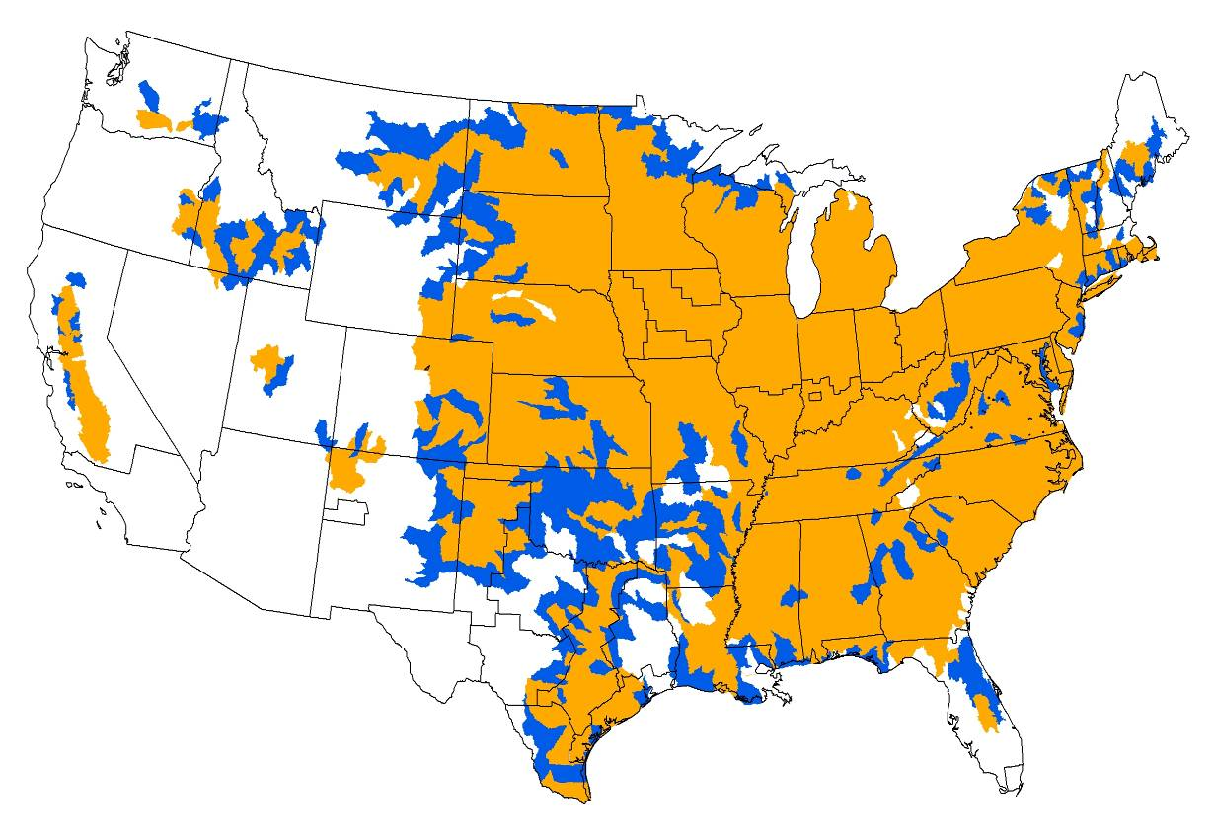
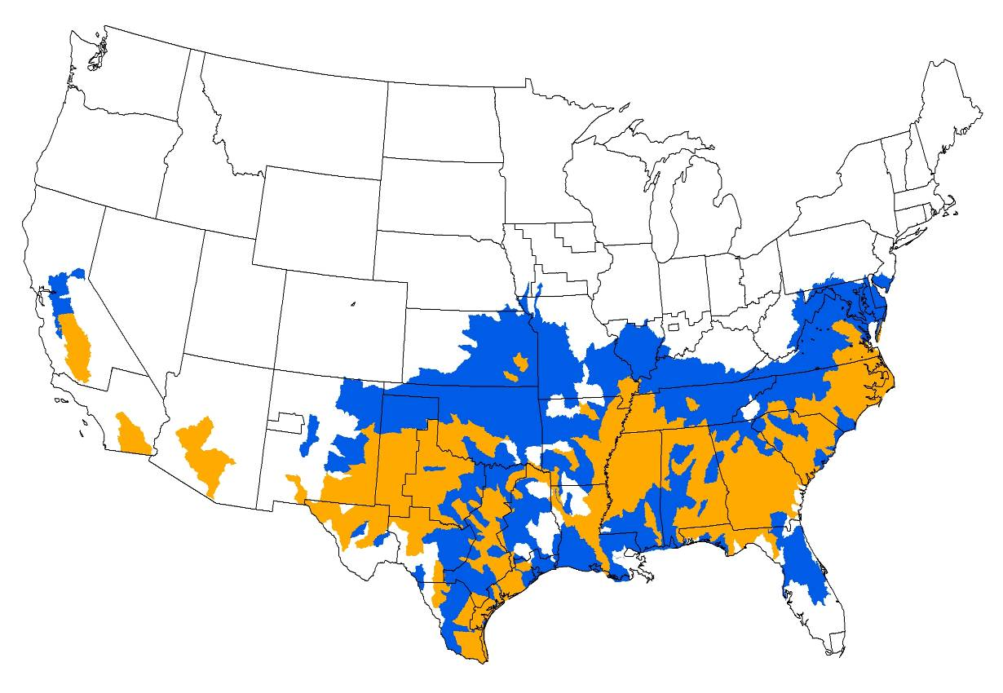
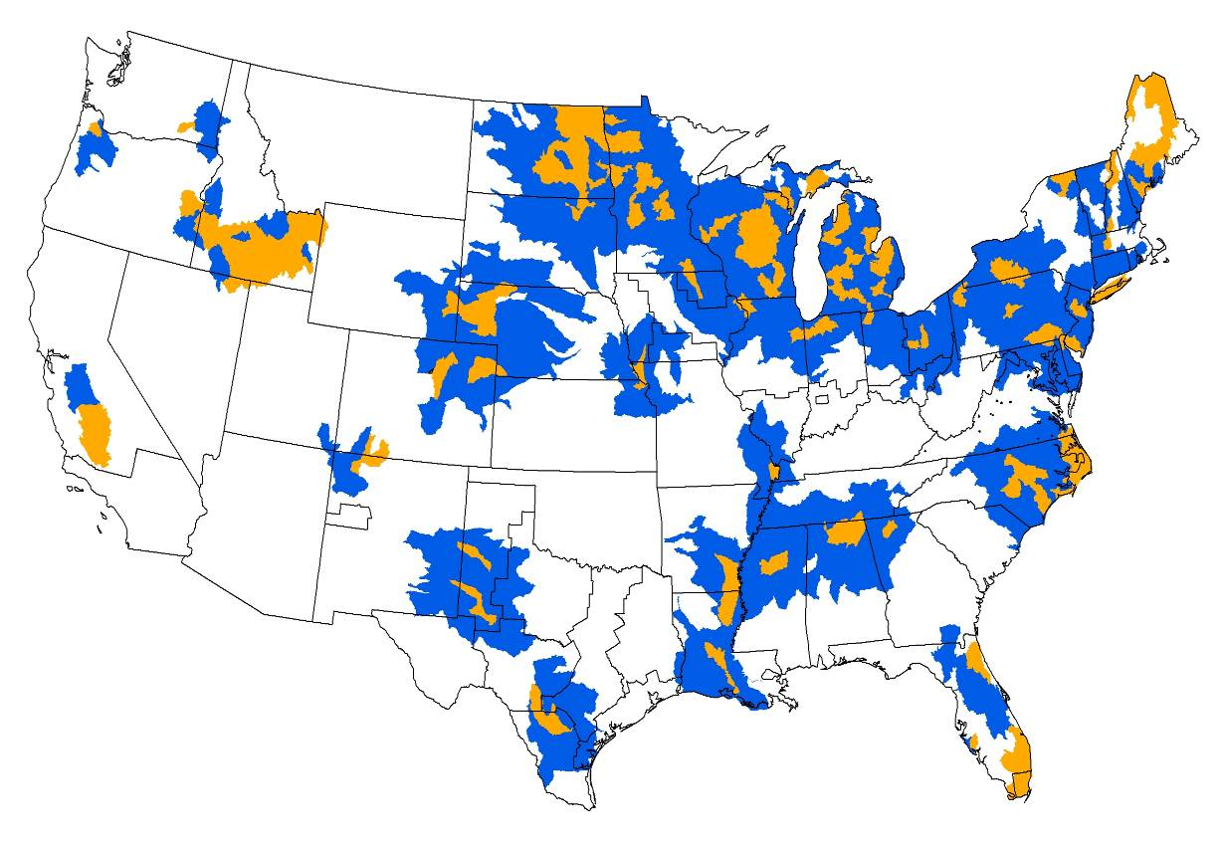
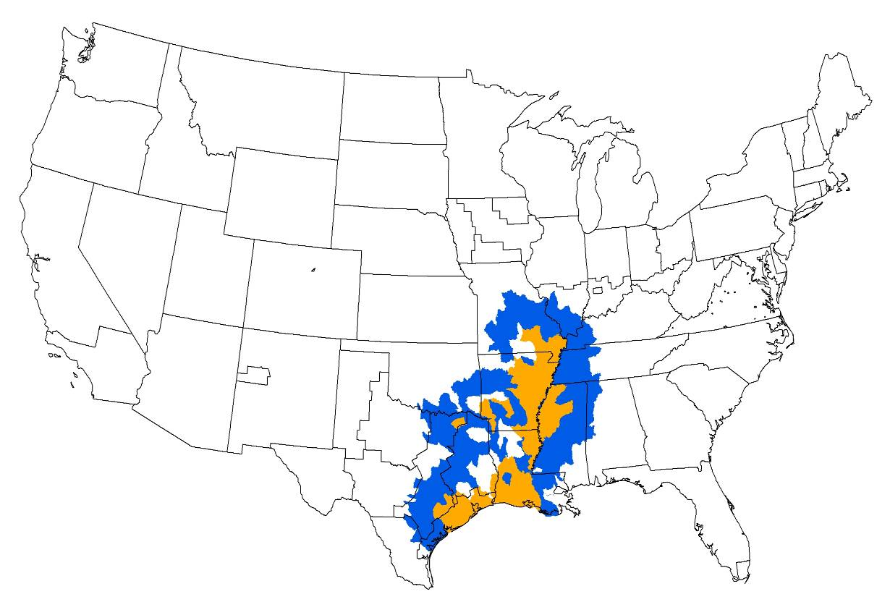
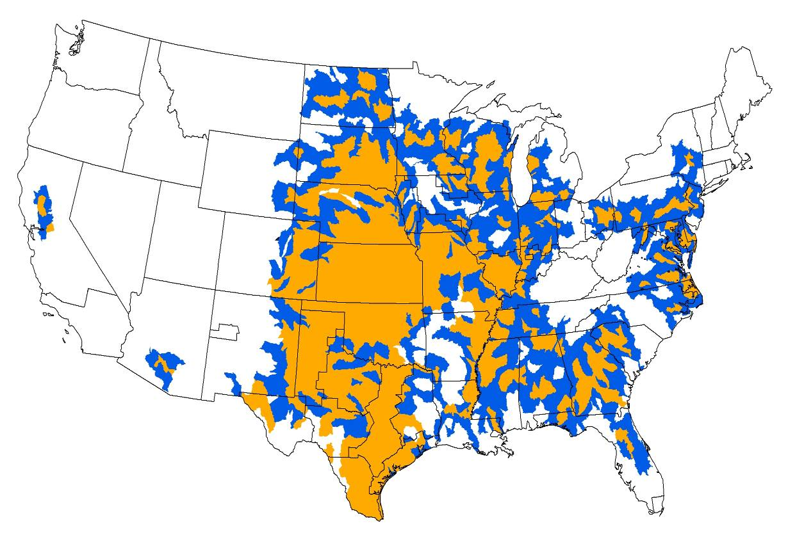
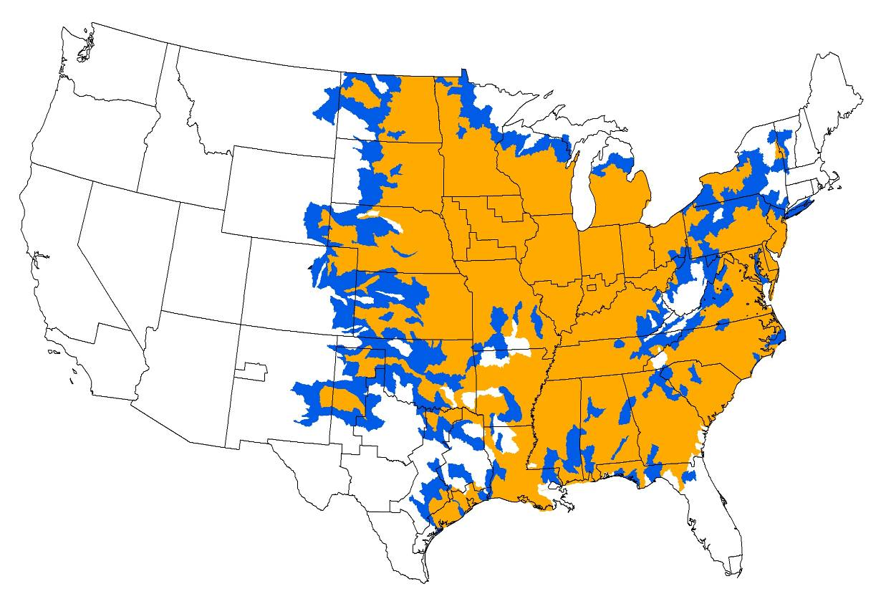
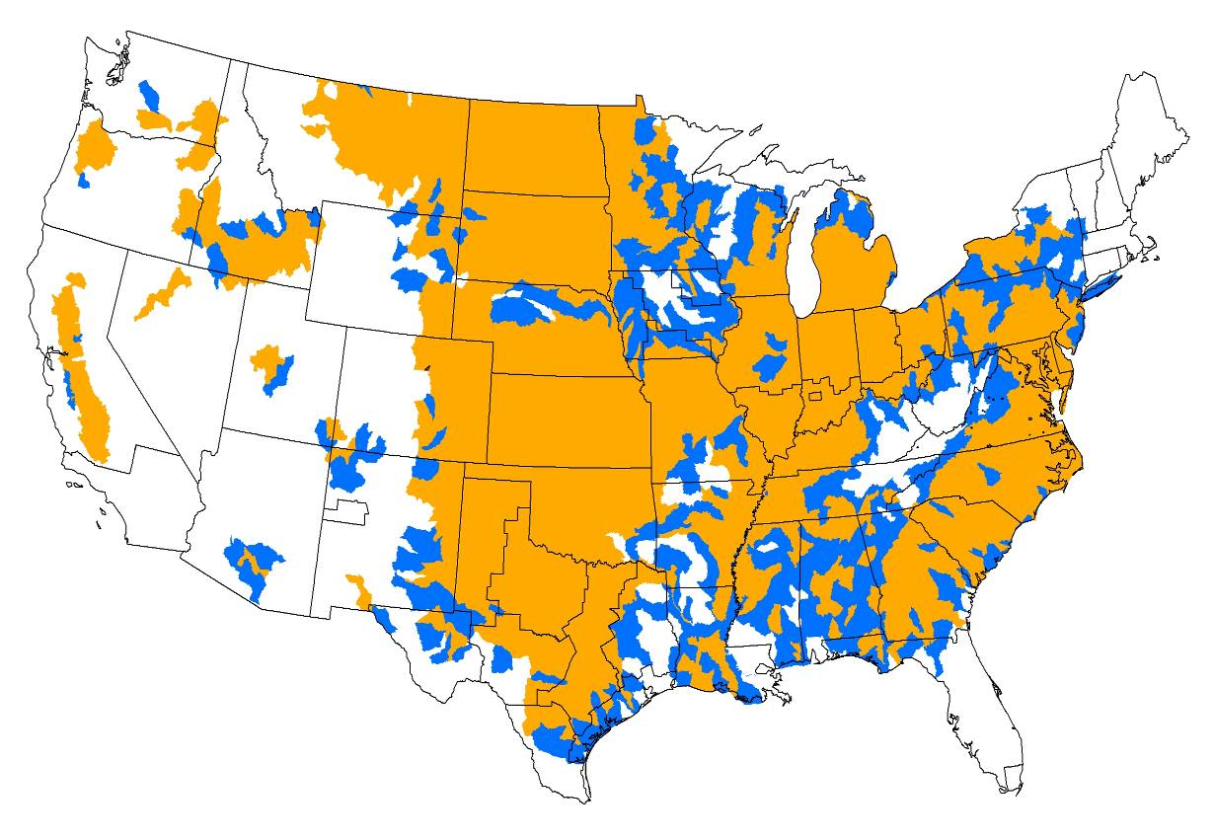
Current and Expanded Crop Production Ranges Modeled in EPIC
Barley
Corn
Cotton
Potatoes
Rice
Sorghum
Soybeans
Wheat

Slide 21
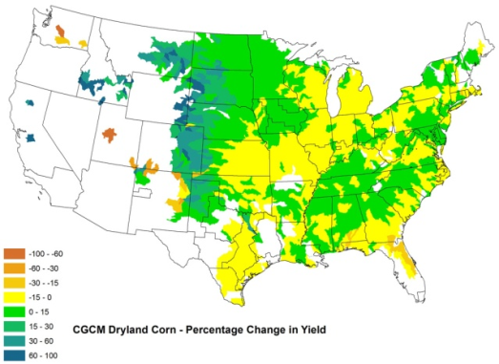
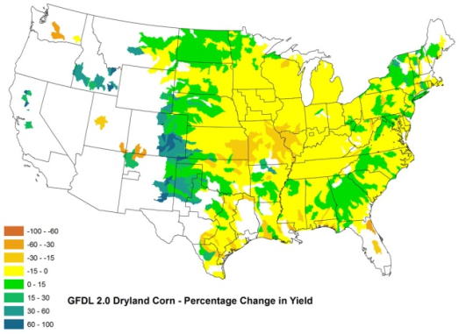
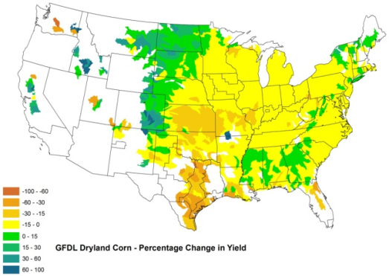
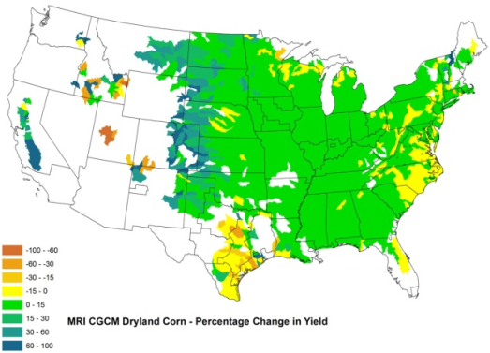
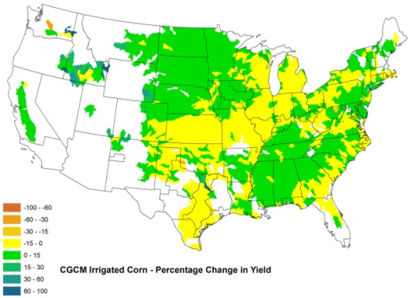
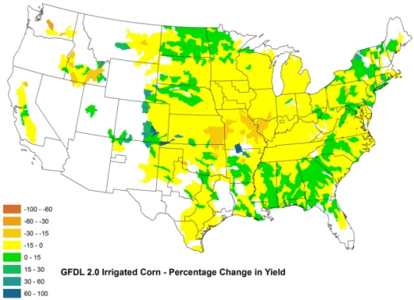
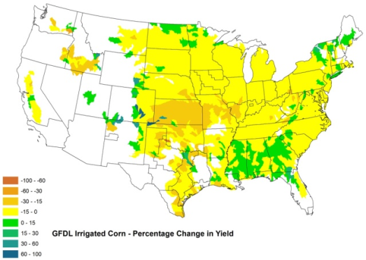
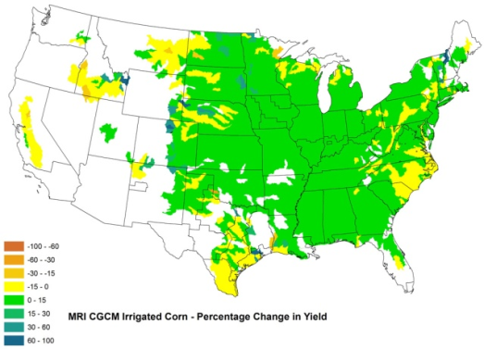
Percentage Change in Dryland and Irrigated Corn Yields Simulated Using EPIC, 2045-2054
Dryland Yields
Irrigated Yields

Slide 22
Percentage Change in Dryland and Irrigated Soybean Yields Simulated Using EPIC, 2045-2054
Dryland Yields
Irrigated Yields

Slide 23
Percentage Change in Dryland and Irrigated Wheat Yields Simulated Using EPIC, 2045-2054
Dryland Yields
Irrigated Yields

Slide 24
Forest and Agricultural Sector Optimization Model (FASOM)
Being used to model economic decisions and assess agricultural market outcomes under alternative scenarios with different yield distributions
  Crop allocation decisions by crop and management categories based on the relative risk and returns to alternative cropping patterns under the yield distributions associated with the climate scenarios
    % change in mean yield
    % change in standard deviation of yield
  Change in equilibrium commodity prices and regional distribution
Equilibrium outcomes depend on relative changes for alternative crops within a region

Slide 25
FASOM Model Structure
Objective: Welfare Maximization
  Land is allocated between activities (and combined with other inputs) based on relative rents (including GHG payments) and suitability to maximize intertemporal welfare
Sectoral and Land Coverage
  Forest – approximately 80 products from private timberland
  Agriculture – crops and pasture
    Over 70 primary and about 60 processed commodities, 20 processed feeds
  Developed – Tracks conversion of forest, crop, and pastureland for development
3 GHGs — CO₂, N₂O, CH₄
  Stocks and flows of GHGs for more than 50 sources and sinks
63 US regions (11 market regions) and international trade with 37 major trading partners
Detailed Bioenergy Market
  Forestry & agricultural dedicated and residue feedstocks
  Tracks production of starch- and sugar-based ethanol, cellulosic ethanol, biodiesel, and bioelectricity

Slide 26
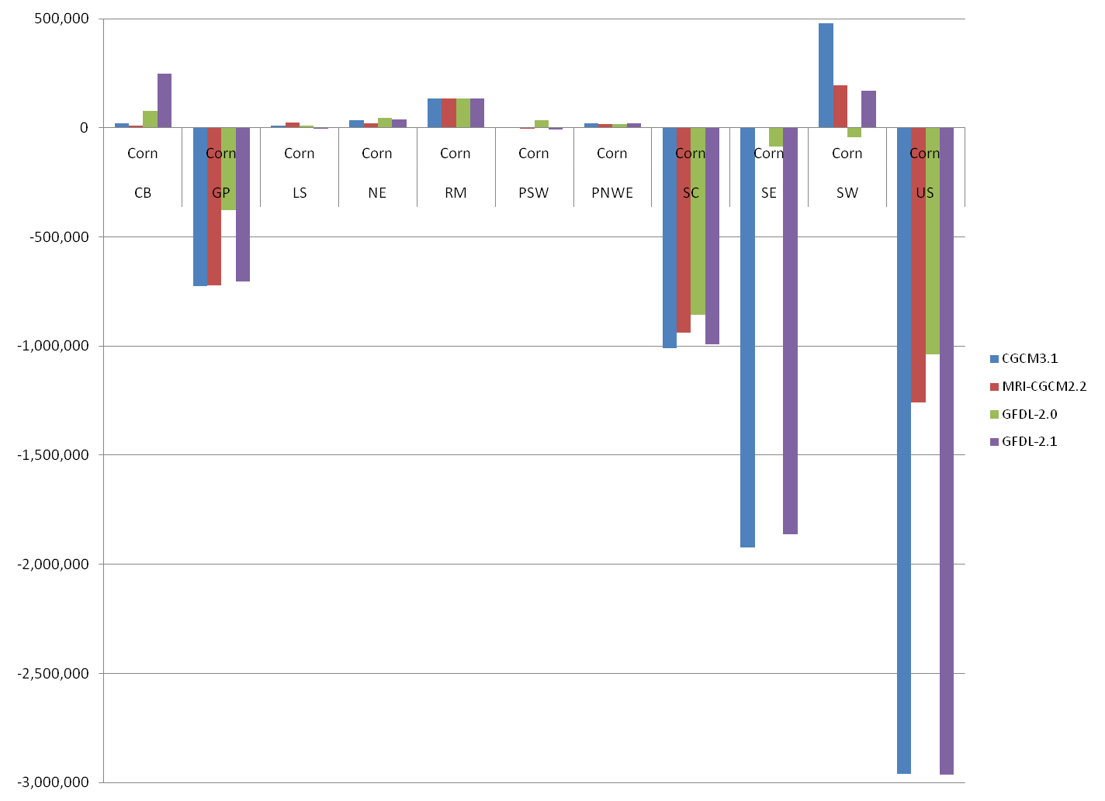
Simulated Changes in Regional Acreage Relative to Baseline, Corn (Acres)
Note: CB=Corn Belt, GP=Great Plains, LS=Lake States, NE=New England, RM=Rocky Mountains, PSW=Pacific Southwest, PNWE=Pacific Northwest East Side, SC=Southcentral, SE=Southeast, SW=Southwest

Slide 27
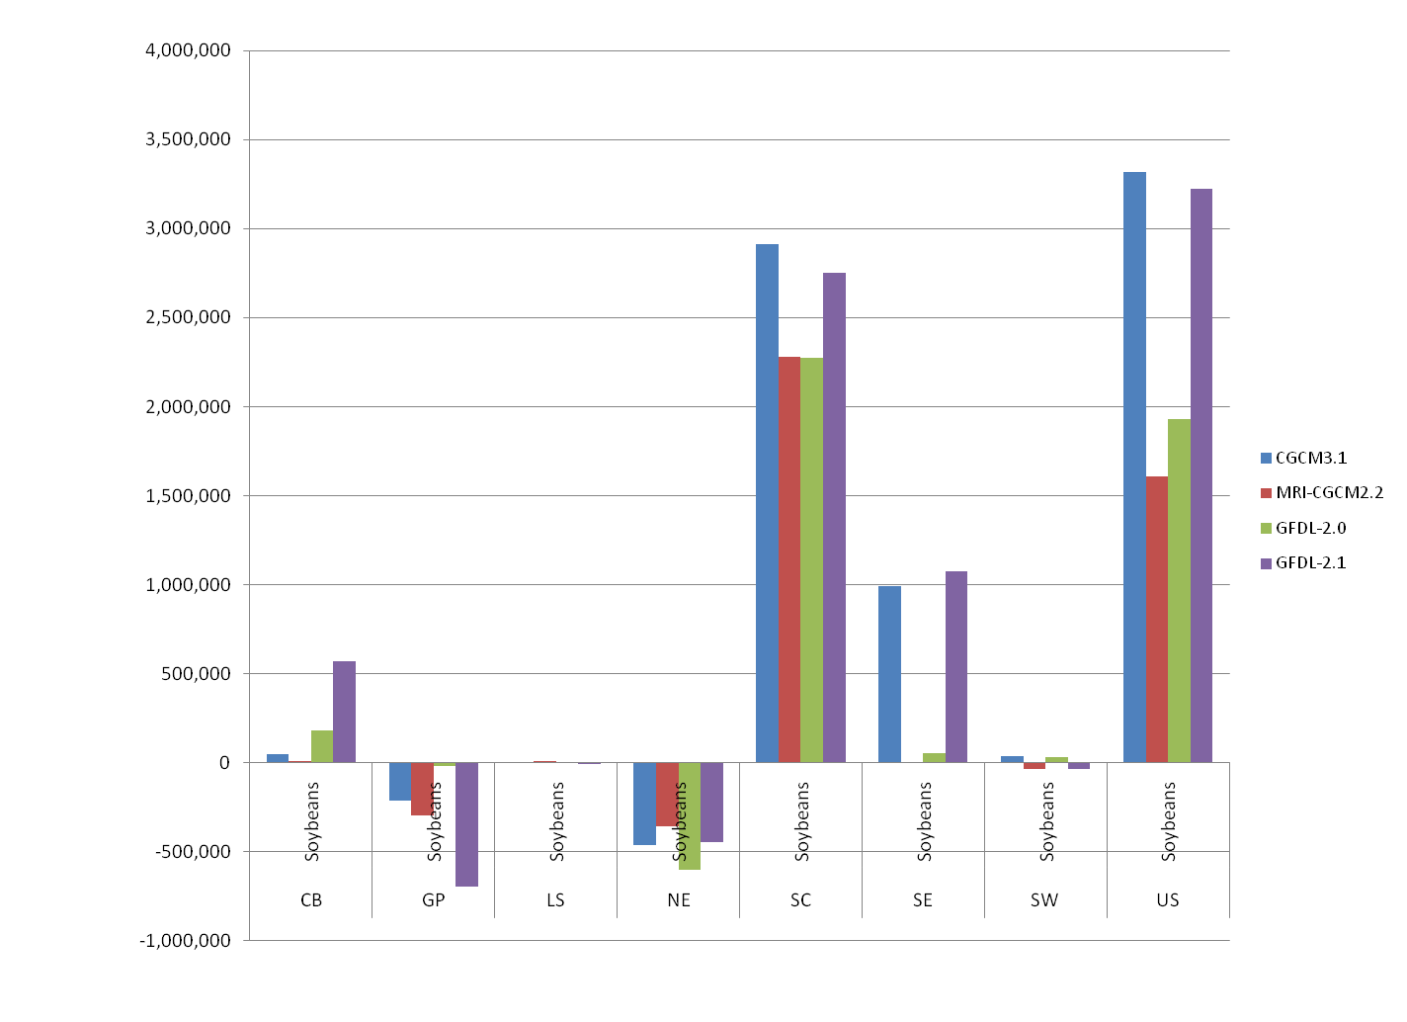
Simulated Changes in Regional Acreage Relative to Baseline, Soybeans (Acres)
Note: CB=Corn Belt, GP=Great Plains, LS=Lake States, NE=New England, RM=Rocky Mountains, PSW=Pacific Southwest, PNWE=Pacific Northwest East Side, SC=Southcentral, SE=Southeast, SW=Southwest

Slide 28
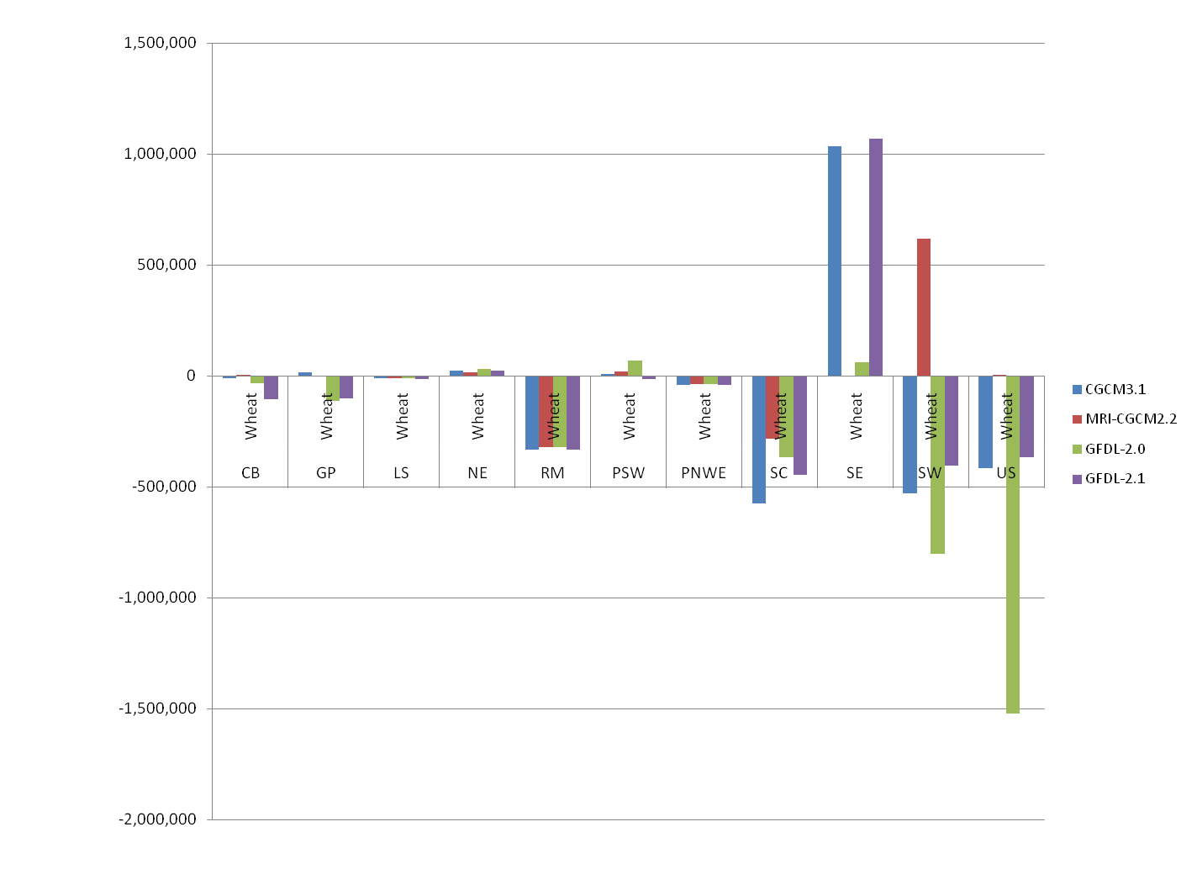
Simulated Changes in Regional Acreage Relative to Baseline, Wheat (Acres)
Note: CB=Corn Belt, GP=Great Plains, LS=Lake States, NE=New England, RM=Rocky Mountains, PSW=Pacific Southwest, PNWE=Pacific Northwest East Side, SC=Southcentral, SE=Southeast, SW=Southwest

Slide 29
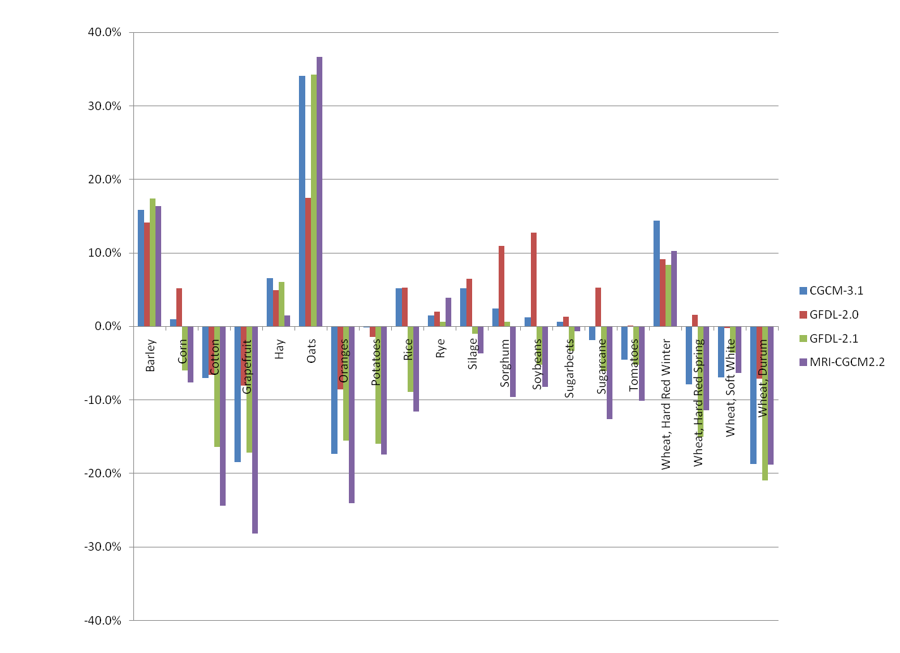
Equilibrium Changes in National Average Yield Relative to Baseline

Slide 30
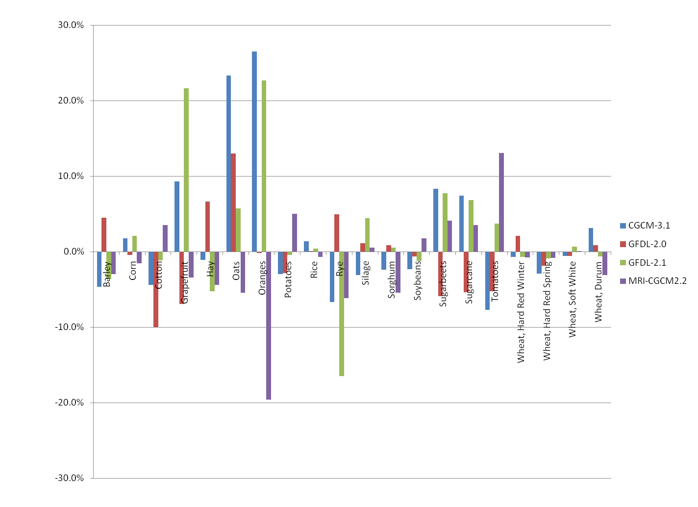
Simulated Changes in Average Market Price Relative to the Baseline

Slide 31
Annual Welfare Change in US Agricultural Sector

Slide 32
Modeling Yield Distributions and Expected Losses
Use the changes in yields and in agronomic potential for producing crops in new regions simulated using EPIC in actuarial models of major crop insurance programs
Incorporate information from the stochastic FASOM model on cropping patterns and equilibrium prices
Provide estimates of changes in the distribution of expected losses (probabilities and sizes or indemnities) under alternative climate scenarios based on simulated yields, prices, and insurance products under each scenario modeled

Slide 33

Estimating Yield Distributions
are the observed yields, are the corresponding yield trends, and is the trend yield in base year 2006
Relied on historical data from USDA NASS (1972-2007) to obtain detrended baseline yields
Regressed district yield (calculated as production/planted acres rather than harvested to more accurately measure yield risk) on linear and quadratic trends
Yield data are then converted to base-year equivalents
where y_{t} are the observed yields, are the corresponding yield trends, and is the trend yield in base year 2006.
The detrended yield observations are then used to construct empirical distributions of district yields (Goodwin and Ker, 1998; Ker and Goodwin, 2000; Ker and Coble, 2003).
Individual farm yields are modeled as parametric distributions around district yields with parameters calibrated to match historical loss costs observed in each district

Slide 34
Estimating Harvest Price Distribution
In addition to yields, distributions of harvest-time prices are needed to calculate loss costs for revenue products. For each crop, we model its harvest price as a function of planting period price and deviation of detrended national yield from its mean.
Lognormal distribution fit to detrended prices
Impose relationship between price and yield on draws

Slide 35
Baseline Yield Distributions
In order to simulate expected loss costs, we first estimate a baseline yield distribution by fitting a parametric beta distribution on the detrended normalized yields over the entire time period
  Beta distribution is consistent with much of the empirical literature on modeling crop yields and tends to be more “flexible” (i.e., cover a wider area in skewness-kurtosis plane) than other parametric distributions (see Goodwin and Ker, 2002; Lu et al., 2008, Mitchell and Knight, 2008; Goodwin, 2008)
Fit beta distributions to these yields
  where α and β are shape parameters, a and b are the lower and upper bounds (respectively), y is the normalized detrended yield and B is the beta function
We assume that lower bound yield value is 0 and upper bound is the maximum observed yield within the state in which a particular district is located. Shape parameters are estimated using ML.

Slide 36
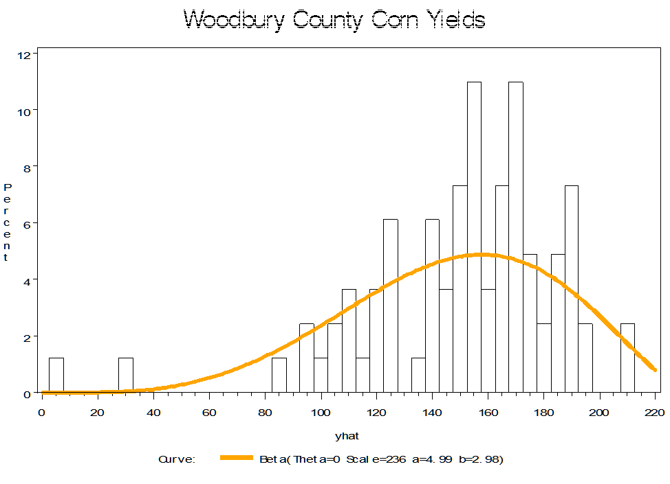
Example of Fitted Beta Distribution, Woodbury County, IA

Slide 37
Preserving Spatial Correlation of Yield Distribution
The approach described above is commonly applied in the crop insurance literature (e.g., Harri et al., 2009)
However, spatial correlation of yield distributions across counties due to weather, pests, and other environmental factors may not be sufficiently reflected
Relatively simple way to incorporate spatial correlation into the shape parameters of the beta distribution is to calculate year- and district-specific α and β parameters conditional on the realized weather, pest, and other events that occurred in that year/district
Instead of a fitting a beta distribution over the entire district time series, we assume that the NASS district yield is an average of a distribution of unobserved farm-level yields.

Slide 38
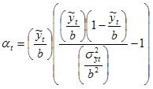
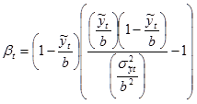
Adjusted Yield Distributions
We assume the yield distribution is beta; the unknowns are the two shape parameters and the maximum farm yield h_{t}
Shape parameters are calculated as:
Where α_{t} and β_{t} are shape parameters for year t and is the variance of the normalized yield

Slide 39
Calibration of Yield Distributions
To calibrate yield distributions for each crop, district, and year, we search for values of and h_{t} that minimize the difference between the simulated and historical aggregate APH loss cost ratios
Simulated aggregate loss cost ratio is calculated as

Slide 40
Calculation of Loss Cost Ratios
Based on the parameters of the beta distributions, we then develop a simulation model to calculate the expected loss costs (and estimate a loss cost distribution) for each district-crop combination
5000 random yield realizations were drawn from the refitted distribution. For each yield draw, we calculate the indemnity for the APH contracts as follows:
Where p_{m} is the price, θ is the coverage level (θ = 0.5, 0.55, …, 0.85), y_{e} is the expected yield, and y is the yield draw. CAT indemnities are calculated the same way except that only 55% of the price is used.
Loss costs at different coverage levels are then calculated for each draw by dividing the indemnity by the yield guarantee (θy_{e})

Slide 41
Summary Statistics of Expected Loss Costs for 2007 APH Corn in Woodbury County, IA without Climate Change (1 million yield draws)

Slide 42

Revenue Insurance
Although multiple revenue product options have more recently been consolidated, we modeled multiple options based on whether revenue guarantees were based on planting time prices or contained an option to recalculate the guarantee at harvest if prices were higher (there are also differences in month and futures contract used):
Loss cost for revenue products is calculated as:

Slide 43
Additional Adjustments
Once the base-year loss costs were simulated for major crops for each of the major insurance products, we estimated a regression to determine the relationship between loss cost ratios for an aggregate of all other crops in the insurance program and those for major crops in that district. These parameters were used to simulate loss cost ratios for the all other crops aggregate in each district/year
Loss cost ratios for CAT should be the same as 50% buy-up if the pool of insured producers has the same yield distribution
  Loss ratios implied were too high to replicate historical losses for CAT, which is consistent with self-selection by less-risky producers
  Thus, we calculated scaling factors for CAT relative to 50% buy-up at the crop/district level based on historical data
Similarly, using the same calibrated yield distributions to generate expected loss cost ratios for a given coverage level across all reinsurance pools generated simulated indemnities too high for premiums in Commercial and too low for those in Developmental or Assigned Risk pools, consistent with companies selected against FCIC. Thus, we calculated scaling factors for reinsurance pools also.

Slide 44
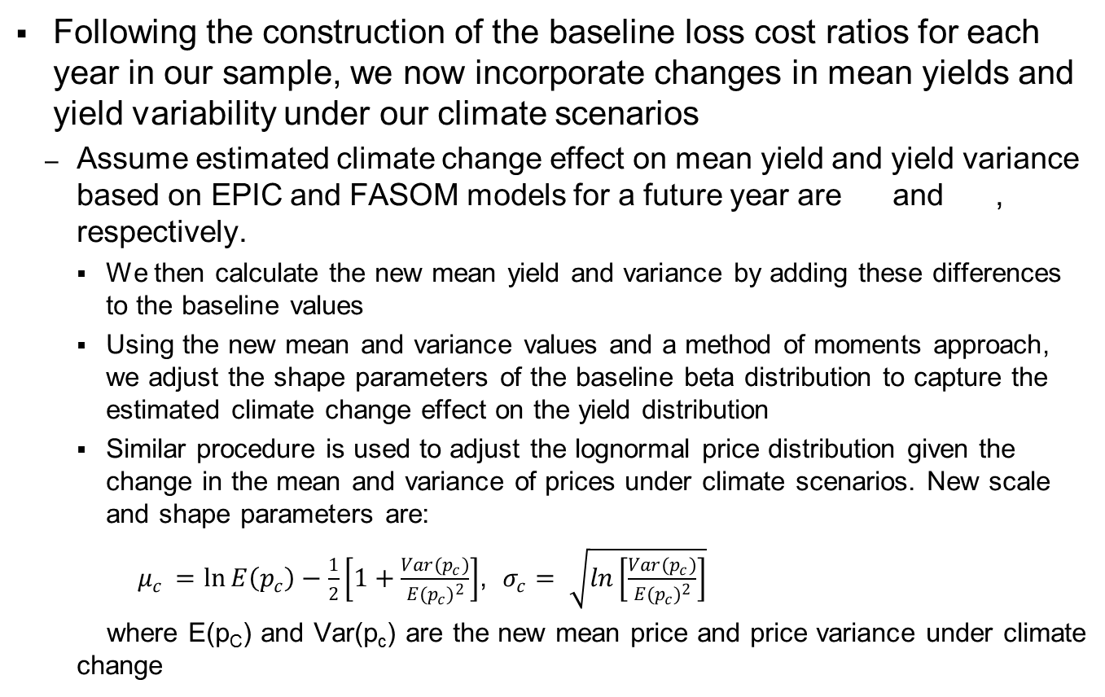
Incorporation of Climate Change Impacts
Following the construction of the baseline loss cost ratios for each year in our sample, we now incorporate changes in mean yields and yield variability under our climate scenarios
  Assume estimated climate change effect on mean yield and yield variance based on EPIC and FASOM models for a future year are and , respectively.
    We then calculate the new mean yield and variance by adding these differences to the baseline values
    Using the new mean and variance values and a method of moments approach, we adjust the shape parameters of the baseline beta distribution to capture the estimated climate change effect on the yield distribution
    Similar procedure is used to adjust the lognormal price distribution given the change in the mean and variance of prices under climate scenarios. New scale and shape parameters are:
    $μ_{c }=\ln{E\left(p_{c}\right)−\frac{1}{2}\left[1+\frac{Var(p_{c})}{{E(p_{c})}^{2}}\right]}$, $σ_{c}= \sqrt{ln\left[\frac{Var(p_{c})}{{E(p_{c})}^{2}}\right]}$
    where E(p_{C}) and Var(p_{c}) are the new mean price and price variance under climate change

Slide 45
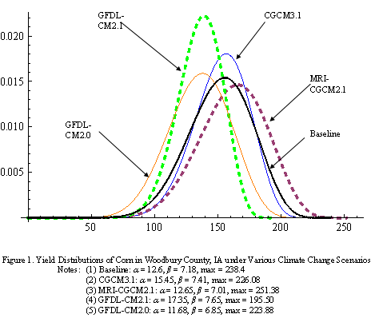
Sample Comparison of Simulated Corn Yield Distributions in Woodbury County, IA Across Climate Scenarios

Slide 46
Standard Reinsurance Agreement Model
Using information developed by the EPIC, Stochastic FASOM, and yield distribution models we estimate the impacts that the SRA has on outcomes under alternative climate change scenarios using the SRA Model (Vedenov et al., 2004; Vedenov et al., 2006)
Objective is to simulate distributions of rates of return from underwriting crop insurance
Model the distribution of loss ratios by state and reinsurance fund for each participating organization reinsured by the FCIC
The model currently includes 10 crops and five major types of insurance
  crops include: barley, corn, cotton, hay, potatoes, rice, soybeans, grain sorghum, and wheat (winter and spring)
  insurance plans include: Catastrophic (CAT), Actual Production History (APH) yield insurance, Crop Revenue Coverage (CRC), Income Protection (IP) (each at 50, 55, 60, 65, 70, 75, 80 and 85% coverage levels), and Revenue Assurance (RA) (at 65, 70, 75, 80 and 85% coverage levels)

Slide 47
Simulated Baseline Returns vs. Actual Historical Returns

Slide 48
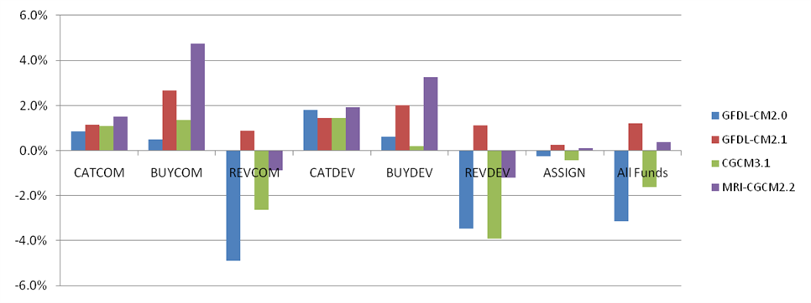
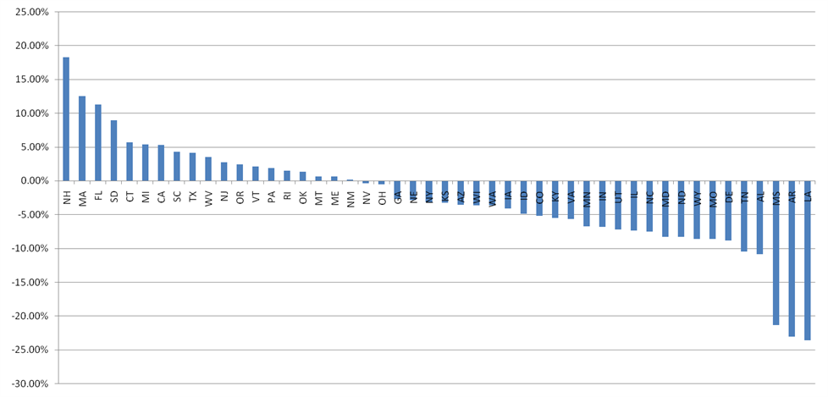
Effects on Returns to Insurance Companies
Relatively small impacts in the aggregate across all crops at the national level (vary from 3.1 percentage points below to 1.2 percentage points above base return of 23.5%)
Reflects risk protection provided to companies by the SRA
Substantially larger impacts on gains to the FCIC than the companies (range from 26.8 below to 14.4 above base simulated return of 12.7%)
Obscures distributional impacts across states

Slide 49
Summary
Crop yields are affected by changes in temperature, precipitation, and other aspects of climate in a very heterogeneous way
In addition to changes in mean yields, changes in variability are important for farmer decisions and probability of losses
  Could have increase in mean yield, but also increase in expected losses (changes in the lower tail of the distribution drive indemnities)
Insurance can help farmers manage risk, but certain crops/regions/coverage levels may become infeasible under climate change
  Need to account for companies selecting against FCIC
Potentially substantial shifts in crop production and commodity markets, though considerable uncertainty
Adaptation is likely to have an important influence

Slide 50
Ongoing and Future Research
Updated climate scenarios and crop models
Need to better account for extreme events
  Using historical data implicitly assumes low frequency high loss events are reflected
  Data series for some crops/regions may not be long enough to capture and probability of these events may change in the future
Behavioral adjustments in insurance purchases and company decisions
Incorporate impacts on pasture, livestock, and forest productivity
International climate impacts on forests and agriculture
Integration of climate impacts and adaptation with mitigation
  Energy prices
  Renewable fuels assumptions
  Technological progress assumptions
  Carbon price paths

